Slide 1


Gause Experiments with Two Yeast Populations Two Species Competition Model
Linear Analysis and Behavior of Model
Outline
1
Gause Experiments with Two Yeast Populations
2
Two Species Competition Model Model and Equilibrium
Fitting the Competition Model
3
Linear Analysis and Behavior of Model Equilibria
Linearization

Slide 2
Gause Experiments with Two Yeast Populations Two Species Competition Model
Linear Analysis and Behavior of Model
Review
Review
Examined data from Gause on cultures of yeast
ODE models are readily solved
Monocultures of yeast fit to well the continuous logistic growth model
Qualitative analysis is performed
Equilibria are found (extinction and carrying capacity) Model is linearized and stability is determined
Created phase portraits, showing model behavior for a 1D model
Remains to study mixed culture with the two species competing for same resource

Slide 3
Gause Experiments with Two Yeast Populations Two Species Competition Model
Linear Analysis and Behavior of Model
Monoculture Yeast Experiments
Monoculture Yeast Experiments with best fitting logistic models
Below is a table combining two experimental studies of S. cerevisiae
Time (hr) | 0 | 1.5 | 9 | 10 | 18 | 18 | 23
Volume | 0.37 | 1.63 | 6.2 | 8.87 | 10.66 | 10.97 | 12.5
Time (hr) | 25.5 | 27 | 34 | 38 | 42 | 45.5 | 47
Volume | 12.6 | 12.9 | 13.27 | 12.77 | 12.87 | 12.9 | 12.7
dP
Logistic model: = 0.25864 P 1 −
P
,
P = 1.2343.
dt 12.7421
0
Below is a table combining two experimental studies of S. kephir
Time (hr) | 9 | 10 | 23 | 25.5 | 42 | 45.5 | 66 | 87 | 111 | 135
Volume | 1.27 | 1 | 1.7 | 2.33 | 2.73 | 4.56 | 4.87 | 5.67 | 5.8 | 5.83
dP
Logistic model: = 0.057442 P 1 −
P
, P = 0.67807.
dt 5.8802
0
These models show that S. cerevisiae grows much faster than S. kephir

Slide 4
Gause Experiments with Two Yeast Populations Two Species Competition Model
Linear Analysis and Behavior of Model
Graph of Data and Logistic Model
The graphs of the data with the best fitting models are shown below.
Saccharomyces cerevisiae
6
5
4
3
2
1
0
Schizosaccharomyces kephir
15
P (t) (Volume)
10
P (t) (Volume)
5
0
0
10
20
30
40
50
0
50
100
150
t (hrs)
t (hrs)
From the timescales, S. cerevisiae grows significantly faster, which is also reflected in the parameter r in the models.

Slide 5
Gause Experiments with Two Yeast Populations Two Species Competition Model
Linear Analysis and Behavior of Model
Mixed Culture Yeast Experiments
Mixed Culture Yeast Experiments: Two yeast species are competing for the same resource.
Time (hr) | 0 | 1.5 | 9 | 10 | 18 | 18 | 23
Vol (S. cerevisiae) | 0.375 | 0.92 | 3.08 | 3.99 | 4.69 | 5.78 | 6.15
Vol (S. kephir ) | 0.29 | 0.37 | 0.63 | 0.98 | 1.47 | 1.22 | 1.46
Time (hr) | 25.5 | 27 | 38 | 42 | 45.5 | 47
Vol (S. cerevisiae) | 9.91 | 9.47 | 10.57 | 7.27 | 9.88 | 8.3
Vol (S. kephir ) | 1.11 | 1.225 | 1.1 | 1.71 | 0.96 | 1.84
Both species show the initial Malthusian growth at low densities with S. cerevisiae growing faster.
The limited nutrient causes the populations to level off. Monocultures reached carrying capacity because of
intraspecies competition.
Two species adds the addition element of interspecies competition, affecting the long term outcome.

Slide 6
Gause Experiments with Two Yeast Populations Two Species Competition Model
Linear Analysis and Behavior of Model
Model and Equilibrium
Fitting the Competition Model
Two Species Competition Model
1
Two Species Competition Model: Let X(t) be the density of one species of yeast and Y (t) be the density of another species of yeast.
Assume each species follows the logistic growth model for interactions within the species.
Model has a Malthusian growth term.
Model has a term for intraspecies competition.
The differential equation for each species has a loss term for
interspecies competition.
Assume interspecies competition is represented by the product of the two species.
If two species compete for a single resource, then
Competitive Exclusion - one species out competes the other and becomes the only survivor
Coexistence - both species coexist around a stable equilibrium

Slide 7
Gause Experiments with Two Yeast Populations Two Species Competition Model
Linear Analysis and Behavior of Model
Model and Equilibrium
Fitting the Competition Model
Two Species Competition Model
2
Two Species Competition Model: The system of ordinary differential equations (ODEs) for X(t) and Y (t) :
dX
dt dY
dt
2
= a X − a X − a XY = f (X,Y )
1 2 3 1
2
= b Y − b Y − b Y X = f (X, Y )
1 2 3 2
First terms with a1 and b1 represent the exponential or Malthusian growth at low densities
The terms a2 and b2 represent intraspecies competition from crowding by the same species
The terms a3 and b3 represent interspecies competition from the second species
Unlike the logistic growth model, this system of ODEs does not have an analytic solution, so we must turn to other analyses.

Slide 8
Gause Experiments with Two Yeast Populations Two Species Competition Model
Linear Analysis and Behavior of Model
Model and Equilibrium
Fitting the Competition Model
Competition Model – Analysis
1
Competition Model: Analysis always begins finding equilibria, which requires:
dX dt
dY dt
= 0 and
= 0,
in the model system of ODEs.
Thus,
2
a X − a X − a X
Y = 0,
1 e 2 e
3 e e
2
b Y − b Y − b X Y
= 0.
1 e 2 e 3 e e
Factoring gives:
Xe(a1 − a2Xe − a3Ye) = 0, Ye(b1 − b2Ye − b3Xe) = 0.

Slide 9
Gause Experiments with Two Yeast Populations Two Species Competition Model
Linear Analysis and Behavior of Model
Model and Equilibrium
Fitting the Competition Model
Competition Model – Analysis
2
The equilibria of the competition model satisfy:
Xe(a1 − a2Xe − a3Ye) = 0, Ye(b1 − b2Ye − b3Xe) = 0.
This system of equations must be solved simultaneously. The first equation gives:
Xe = 0 or a1 − a2Xe − a3Ye = 0.
If Xe = 0, then from the second equation we have either the extinction equilibrium,
(Xe, Ye) = (0, 0)
or the competitive exclusion equilibrium (with Y winning):
b
1
(X , Y ) = 0, ,
e e
b2
where Ye is at carrying capacity.

Slide 10
Gause Experiments with Two Yeast Populations Two Species Competition Model
Linear Analysis and Behavior of Model
Model and Equilibrium
Fitting the Competition Model
Competition Model – Analysis
3
Continuing the equilibria of the competition model: If
a₁ − a₂X_{e} − a₃Y_{e} = 0 from the first equation, then from the second
equation we have either the competitive exclusion equilibrium
(with X winning):
a
1
(X , Y ) =
, 0 ,
e e
a₂
where X_{e} is at carrying capacity or the nonzero equilibrium:
a b − a b
a b − a b
(X , Y ) =
1 2 3 1
2 1 1 3
e e
, .
a₂b₂ − a₃b₃ a₂b₂ − a₃b₃
If X_{e} > 0 and Y_{e} > 0, then we obtain the cooperative equilibrium
with neither species going extinct.
Note: This last equilibrium could have a negative X_{e} or Y_{e}, depending on the values of the parameters.

Slide 11
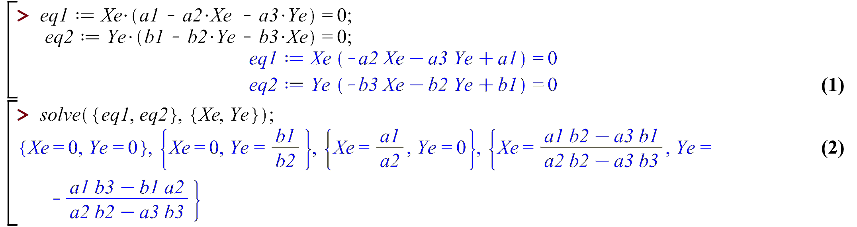
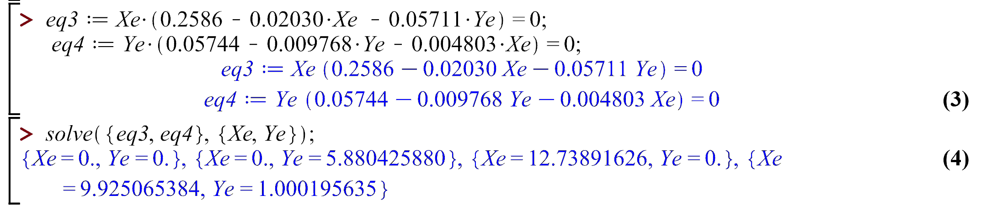
Gause Experiments with Two Yeast Populations Two Species Competition Model
Linear Analysis and Behavior of Model
Model and Equilibrium
Fitting the Competition Model
Maple Equilibrium
Maple can readily be used to find equilibria:
Later we find the numerical values of the parameters, so Maple easily finds all equilibria:
Note: The positive equilibrium is close to the late data points.

Slide 12
Gause Experiments with Two Yeast Populations Two Species Competition Model
Linear Analysis and Behavior of Model
Model and Equilibrium
Fitting the Competition Model
Nullclines
1
Equilibrium analysis shows there are always the extinction and two competitive exclusion equilibria with the latter going to carrying capacity for one of the species.
Provided a₂b₂ − a₃b₃ =/ 0, there is another equilibrium, and it
satisfies: 1. X_{e} ≤ 0 and Y_{e} > 0 or 2. X_{e} > 0 and Y_{e} ≤ 0 or 3. X_{e} > 0
and Y_{e} > 0.
We concentrate our studies on Case 3, where there exists a positive cooperative equilibrium.
Finding equilibia can be done geometrically using nullclines. Nullclines are simply curves where
dX dt
dY dt
= 0 and
= 0.

Slide 13
Gause Experiments with Two Yeast Populations Two Species Competition Model
Linear Analysis and Behavior of Model
Model and Equilibrium
Fitting the Competition Model
Nullclines
2
For the competition model, the nullclines satisfy:
dX dY
= X(a1 − a2X − a3Y ) = 0 and = Y (b1 − b2Y − b3X) = 0,
dt dt
where the first equation has solutions only flowing in the Y -direction and the second equation has solutions only flowing in the X-direction.
Equilibria occur where the curves intersect.
The nullclines for the competition model are only straight lines:
The ^{dX} = 0 has X = 0 or the Y -axis preventing solutions in X from
dt
becoming negative.
The ^{dY} = 0 has Y = 0 or the X-axis preventing solutions in Y from
dt
becoming negative.
The other two nullclines are straight lines with negative slopes passing through the positive quadrant, X > 0 and Y > 0.

Slide 14
Gause Experiments with Two Yeast Populations Two Species Competition Model
Linear Analysis and Behavior of Model
Model and Equilibrium
Fitting the Competition Model
Nullclines
3
Example 1: Consider the competition model:
dX
dt dY
dt
2
= 0.1 X − 0.01 X − 0.02 XY,
2
= 0.2 Y − 0.03 Y − 0.04 XY.
Nullclines where ^{dX} = 0 are
dt
1
X = 0.
2
0.1 − 0.01 X − 0.02 Y = 0 or Y = 5 − 0.2 X.
Nullclines where ^{dY} = 0 are
dt
1
Y = 0.
20
4
2
0.2 − 0.03 Y − 0.04 X = 0 or Y = − X.
3 3
Equilibria occur at intersections of a nullcline with ^{dX} = 0 and one with ^{dY} = 0.
dt dt
20
The 4 equilibria are (0, 0), 0, , (10, 0), and (2, 4).
3

Slide 15
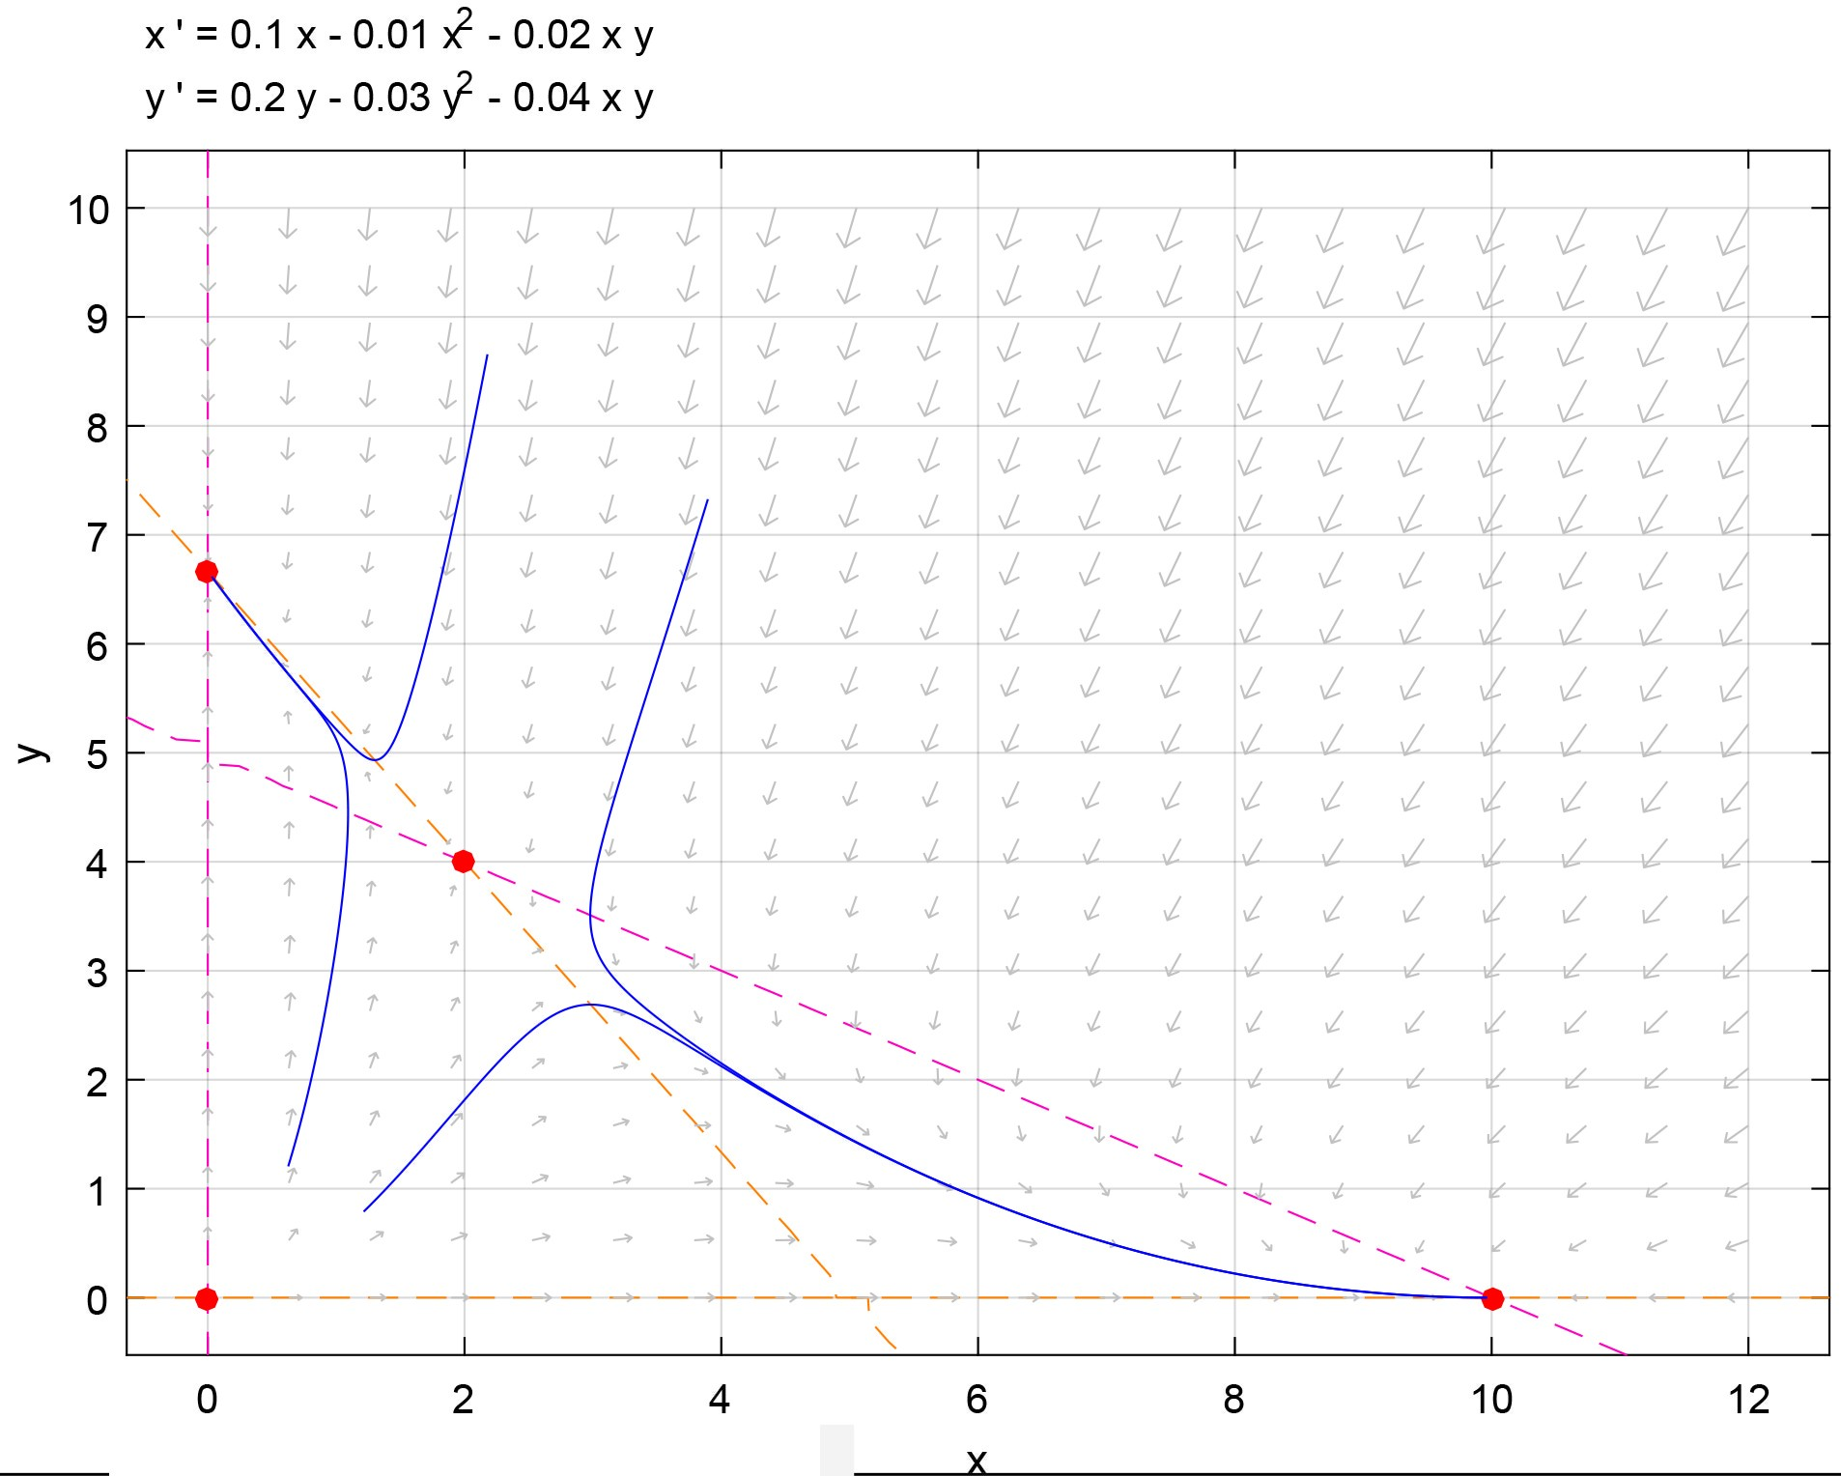
Gause Experiments with Two Yeast Populations Two Species Competition Model
Linear Analysis and Behavior of Model
Model and Equilibrium
Fitting the Competition Model
Nullclines
4
The figure below was generated with pplane8 and shows that Example 1
exhibits competitive exclusion with all solutions going to either the carrying
20
capacity equilibria, (X , Y ) = 0, or (X , Y ) = (10, 0).
e e
3
e e

Slide 16
Gause Experiments with Two Yeast Populations Two Species Competition Model
Linear Analysis and Behavior of Model
Model and Equilibrium
Fitting the Competition Model
Nullclines
5
Example 2: Consider the competition model:
dX
dt dY
dt
2
= 0.1 X − 0.02 X − 0.01 XY,
2
= 0.2 Y − 0.04 Y − 0.03 XY.
Nullclines where ^{dX} = 0 are
dt
1
X = 0.
2
0.1 − 0.02 X − 0.01 Y = 0 or Y = 10 − 2 X.
Nullclines where ^{dY} = 0 are
dt
1
Y = 0.
2
0.2 − 0.04 Y − 0.03 X = 0 or Y = 5 − 0.75 X.
Equilibria occur at intersections of a nullcline with ^{dX} = 0 and one with ^{dY} = 0.
dt dt
The 4 equilibria are (0, 0), (0, 5), (5, 0), and (4, 2).

Slide 17
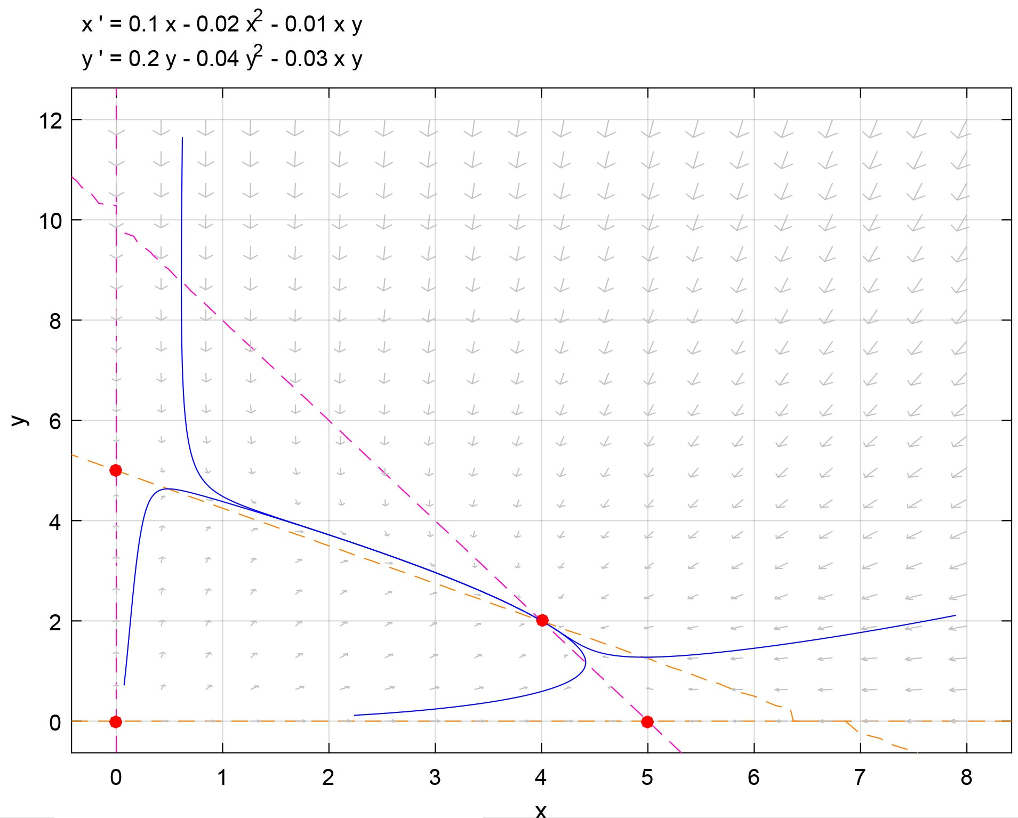
Gause Experiments with Two Yeast Populations Two Species Competition Model
Linear Analysis and Behavior of Model
Model and Equilibrium
Fitting the Competition Model
Nullclines
6
The figure below was generated with pplane8 and shows that Example 2 exhibits cooperation with all solutions going toward the nonzero equilibrium, (Xe, Ye) = (2, 4).

Slide 18
Gause Experiments with Two Yeast Populations Two Species Competition Model
Linear Analysis and Behavior of Model
Model and Equilibrium
Fitting the Competition Model
Fitting the Competition Model
1
Fitting the Competition Model: Need to find the parameters for model with the mixed culture data.
The examples above show the competition model has varying behavior depending on the parameters of the specific system.
Unlike the monocultures, which only required curve fitting, this system of ODEs doesn’t have an exact solution.
Must fit data using an numerical ODE solver.
The yeast competition model has 6 unknown parameters and
2 unknown initial conditions.
Need to use known information to reduce the number of parameters to be fit numerically.

Slide 19
Gause Experiments with Two Yeast Populations Two Species Competition Model
Linear Analysis and Behavior of Model
Model and Equilibrium
Fitting the Competition Model
Fitting the Competition Model
2
In the absence of the other yeast species and assuming the same experimental conditions, the competition model should match the monoculture logistic models.
This assumption implies that the rate constants, a₁, a₂, b₁, and
b₂, come from fitting the logistic growth data.
Thus, we have:
a₁ = 0.25864, a₂ = 0.020298, b₁ = 0.057442, b₂ = 0.0097687.
Thus, the parameter search reduces to the initial conditions and
a₃ and b₃, which is only 4 parameters.

Slide 20
Gause Experiments with Two Yeast Populations Two Species Competition Model
Linear Analysis and Behavior of Model
Model and Equilibrium
Fitting the Competition Model
Fitting the Competition Model
3
Since the system of ODEs does not have an exact solution, we employ a MatLab ODE solver.
MatLab has a Runge-Kutta-Fehlberg ODE solver.
This solver fairly accurately solves the model system in the range of parameters of interest.
We need the solution at the times the data are recorded; however, there is a quirk that the ODE23 solver is unable to handle two data points recorded at the same time.
This requires adjustments in the sum of square errors program to account for the repeated data point.

Slide 21
Gause Experiments with Two Yeast Populations Two Species Competition Model
Linear Analysis and Behavior of Model
Model and Equilibrium
Fitting the Competition Model
Fitting the Competition Model
4
Outline of Program
Load the data from the experiments.
Simulate the competition model with a reasonable set of parameters and initial conditions, recording the model values at the times matching the experimental times.
Compute the sum of square errors between the experimental data and the simulated data.
Use the MatLab program fminsearch to find the least sum of square errors by changing the unknown parameters a₃ and b₃ and initial conditions X(0) and Y (0).
Complications are introduced in the program to manage the repeated data at t = 18.

Slide 22
Gause Experiments with Two Yeast Populations Two Species Competition Model
Linear Analysis and Behavior of Model
Model and Equilibrium
Fitting the Competition Model
MatLab Code for Fitting the Competition Model 1
The primary MatLab script is the following:
1 load yeast
2 global A1 A2 B1 B2;
3 A1 = 0.25864; A2 = 0.020298;
4 B1 = 0.057442; B2 = 0.0097687;
5 p = [0.4 0.63 0.057 0.0048];
6 p1 = fminsearch(@leastcomp2,p,[],tdmix,scdmix,skdmix)
This script downloads the data, sets up Global variables from the monoculture logistic models, gives a good initial guess for the parameters, and calls the fminsearch routine.

Slide 23
Gause Experiments with Two Yeast Populations Two Species Competition Model
Linear Analysis and Behavior of Model
Model and Equilibrium
Fitting the Competition Model
MatLab Code for Fitting the Competition Model 2
Primary MatLab program computes the sum of square errors:
1 function J = leastcomp2(p,tdata,xdata,ydata)
2 global A1 A2 B1 B2
3 [td,M] = reduct(tdata);
4 n1 = length(td);
5 [t,y] = ...
ode23(@compet,td,[p(1),p(2)],[],A1,A2,p(3),B1,B2,p(4));
6 xd = [xdata(1:M),xdata(M+2:n1+1)];
7 yd = [ydata(1:M),ydata(M+2:n1+1)];
8 errx = y(:,1)-xd(1:n1)';
9 erry = y(:,2)-yd(1:n1)';
10 J = errx'*errx + erry'*erry;
11 J = J + (y(M,1)-xdata(M+1))ˆ2 + ...
(y(M,2)-ydata(M+1))ˆ2;
12 end
Data sets with unique values for each time would remove lines 3, 4, 6, 7, and 11 and simplify lines 8 and 9.

Slide 24
Gause Experiments with Two Yeast Populations Two Species Competition Model
Linear Analysis and Behavior of Model
Model and Equilibrium
Fitting the Competition Model
MatLab Code for Fitting the Competition Model 3
The MatLab function for the competition model is:
1 function dydt = compet(t,y,a1,a2,a3,b1,b2,b3)
2 % Competition Model for Two Species
3 tmp1 = a1*y(1) - a2*y(1)ˆ2 - a3*y(1)*y(2);
4 tmp2 = b1*y(2) - b2*y(2)ˆ2 - b3*y(1)*y(2);
5 dydt = [tmp1; tmp2];
6 end
This system of ODEs is inserted into the MatLab
Runge-Kutta-Fehlberg ODE solver with the appropriate parameters.
The ODE23 solver finds the simulated solution at the times corresponding to the experimental data, which are used for the sum of square errors.

Slide 25
Gause Experiments with Two Yeast Populations Two Species Competition Model
Linear Analysis and Behavior of Model
Model and Equilibrium
Fitting the Competition Model
MatLab Code for Fitting the Competition Model 4
MatLab function that sorts data and finds the repeated time:
1 function [td,i] = reduct(tdata)
2 % Data reduction - Repeat t-values
3 % Finds index and removes time for ODE23
4 n = length(tdata);
5 temp = sort(tdata);
6 td = [temp(1)]; i = [];
7 for k = 1:n-1
8 if (temp(k)==temp(k+1))
9 i = [i,k];
10 else
11 td = [td,temp(k+1)];
12 end
13 end
14 end
The code is substantially simpler without this quirk!

Slide 26
Gause Experiments with Two Yeast Populations Two Species Competition Model
Linear Analysis and Behavior of Model
Model and Equilibrium
Fitting the Competition Model
Competition Model with Best Parameters 1
The MatLab code above gives the best fitting interspecies competition parameters for the competition model are:
a₃ = 0.057011 and b₃ = 0.0047576
and initial conditions:
X(0) = 0.41095 and Y (0) = 0.62578.
The least sum of square errors is 19.312.
The Gause mixed culture data are best fit by the competition model:
dX dt dY dt
2
= 0.25864 X − 0.020298 X − 0.057011 XY ,
2
= 0.057442 Y − 0.0097687 Y − 0.0047576 XY .

Slide 27

Gause Experiments with Two Yeast Populations Two Species Competition Model
Linear Analysis and Behavior of Model
Model and Equilibrium
Fitting the Competition Model
Competition Model with Best Parameters 2
The best fitting competition model is readily simulated and compared to the Gause mixed culture data:
12
10
8
6
4
2
0
0
5
10 15 20 25 30 35 40 45 50

Slide 28
Gause Experiments with Two Yeast Populations Two Species Competition Model
Linear Analysis and Behavior of Model
Equilibria Linearization
Competition Model Analysis
Competition Model Analysis:
dX dt dY dt
2
= f (X,Y ) = 0.25864 X − 0.020298 X − 0.057011 XY ,
1
2
= f (X, Y ) = 0.057442 Y − 0.0097687 Y − 0.0047576 XY ,
2
X(0) = 0.41095 and Y (0) = 0.62578.
Begin by finding all equilibria.
Draw the nullclines and study behavior. Linearize at each of the equilibria.
Interpret the results and simulate long term behavior.

Slide 29
Gause Experiments with Two Yeast Populations Two Species Competition Model
Linear Analysis and Behavior of Model
Equilibria Linearization
Equilibria for Competition Model
Equilibria for Competition Model: Let the equilibria for
S. cerevisiae and S. kephir be X_{e} and Y_{e}, respectively
Xe(0.25864 − 0.020298Xe − 0.057011Ye)
Ye(0.057442 − 0.0097687Ye − 0.0047576Xe)
= 0
= 0
Must solve the above equations simultaneously, giving 4 equilibria
Extinction equilibrium, (X_{e}, Y_{e}) = (0, 0)
Carrying capacity equilibria, (X_{e}, Y_{e}) = (12.742, 0) and (X_{e}, Y_{e}) = (0, 5.8802)
Coexistence equilibrium, (X_{e}, Y_{e}) = (10.257, 0.88482)

Slide 30
Gause Experiments with Two Yeast Populations Two Species Competition Model
Linear Analysis and Behavior of Model
Equilibria Linearization
Linearization of Competition Model
Linearization of Competition Model: With equilibria X_{e} and Y_{e}, let u = X − X_{e} and v = Y − Y_{e}
 
∂f (X ,Y ) ∂f
1 (Xe,Ye)
u˙
1 e e
∂u
∂v
u
=
 
v˙
∂f (X ,Y )
∂f (X ,Y )
v
2 e e
∂u
2 e e
∂v
so the linear system is
,
u˙ where | ₌ a₁ − 2a₂X_{e} − a₃Y_{e} | a₃X_{e} u b₂Y_{e} − b₃X_{e} v
 | a₁ = 0.25864 a₂ = 0.020298 b₁ = 0.057442 b₂ = 0.0097687 | a₃ = 0.057011 b₃ = 0.0047576
v˙
b₃Y_{e}
b₁ − 2

Slide 31
Gause Experiments with Two Yeast Populations Two Species Competition Model
Linear Analysis and Behavior of Model
Equilibria Linearization
Local Stability of Competition Model
Local Stability of Competition Model: At the equilibrium, (X_{e}, Y_{e}) = (0, 0)
u˙ v˙
=
0.25864 0 u
0 0.057442 v
,
which has eigenvalues λ₁ = 0.25864 and λ₂ = 0.057442, so this
equilibrium is an Unstable Node
At the equilibrium, (X_{e}, Y_{e}) = (12.742, 0)
u˙ −0.25863 0.72643
v˙ 0 −0.0031793 v
u
= ,
which has eigenvalues λ₁ = −0.25863 and λ₂ = −0.0031793, so this
equilibrium is a Stable Node

Slide 32
Gause Experiments with Two Yeast Populations Two Species Competition Model
Linear Analysis and Behavior of Model
Equilibria Linearization
Local Stability of Competition Model
Local Stability of Competition Model: At the equilibrium, (X_{e}, Y_{e}) = (0, 5.8802)
u˙ −0.076596 0
v˙
u
=
0.027976 −0.057442 v
,
which has eigenvalues λ₁ = −0.076596 and λ₂ = −0.057442, so this
equilibrium is a Stable Node
At the equilibrium,
(X_{e}, Y_{e}) = (10.257, 0.88482)
u˙ −0.20820 0.58476 u
v˙ 0.0042096 −0.0086438 v
= ,
which has eigenvalues λ₁ = −0.21985 and λ₂ = 0.0030111, so this
equilibrium is a Saddle Node (weak in the repelling direction)

Slide 33
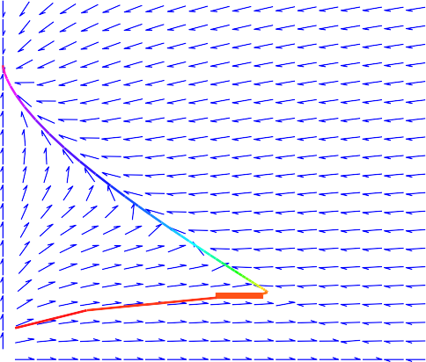
Gause Experiments with Two Yeast Populations Two Species Competition Model
Linear Analysis and Behavior of Model
Equilibria Linearization
Competition Model
Competition Model Phase Portrait: Plot shows nullclines and solution trajectory

Slide 34
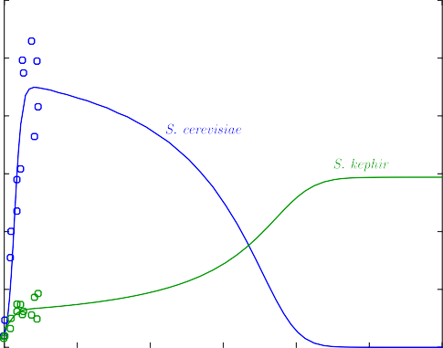
Gause Experiments with Two Yeast Populations Two Species Competition Model
Linear Analysis and Behavior of Model
Equilibria Linearization
Competition Model
Competition Model Time Series: Plot shows the solution trajectories
12
10
8
6
4
2
0
0 100 200 300 400 500 600

Slide 35
Gause Experiments with Two Yeast Populations Two Species Competition Model
Linear Analysis and Behavior of Model
Equilibria Linearization
Behavior of Yeast Competition Model
Competition Model Summary
The local analysis suggests that the least squares best fit to the Gause data would result in the competitive exclusion of one species over time.
Competitive exclusion is very common among similar species.
The phase portrait plot with nullclines suggests that S. kephir has a competitive advantage over long time.
The phase portrait shows that rapid growth of S. cerevisiae has solutions moving quickly in the horizontal direction, yet ultimately, the slower growing S. kephir can dominate the culture.
The eigenvalue analysis helps explain the local behavior, including a local attraction of the cooperative equilibrium before ultimately repelling of this saddle node.

